Slide 1
LU Decomposition
Anders Arnold
Varun Singh
Gourab Sarkar
Nikita Jetwani

Slide 2
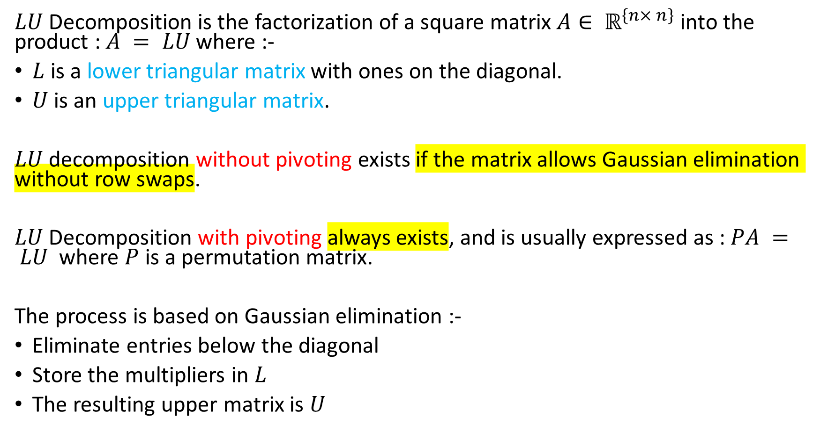
What is LU Decomposition ?
$LU$ Decomposition is the factorization of a square matrix $A∈ ℝ^{\left\{n× n\right\}}$ into the product : $A = LU$where :-
$L$ is a lower triangular matrix with ones on the diagonal.
$U$ is an upper triangular matrix.
$LU$ decomposition without pivoting exists if the matrix allows Gaussian elimination without row swaps.
$LU$ Decomposition with pivoting always exists, and is usually expressed as : $PA = LU$ where $P$ is a permutation matrix.
The process is based on Gaussian elimination :-
Eliminate entries below the diagonal
Store the multipliers in $L$
The resulting upper matrix is $U$

Slide 3
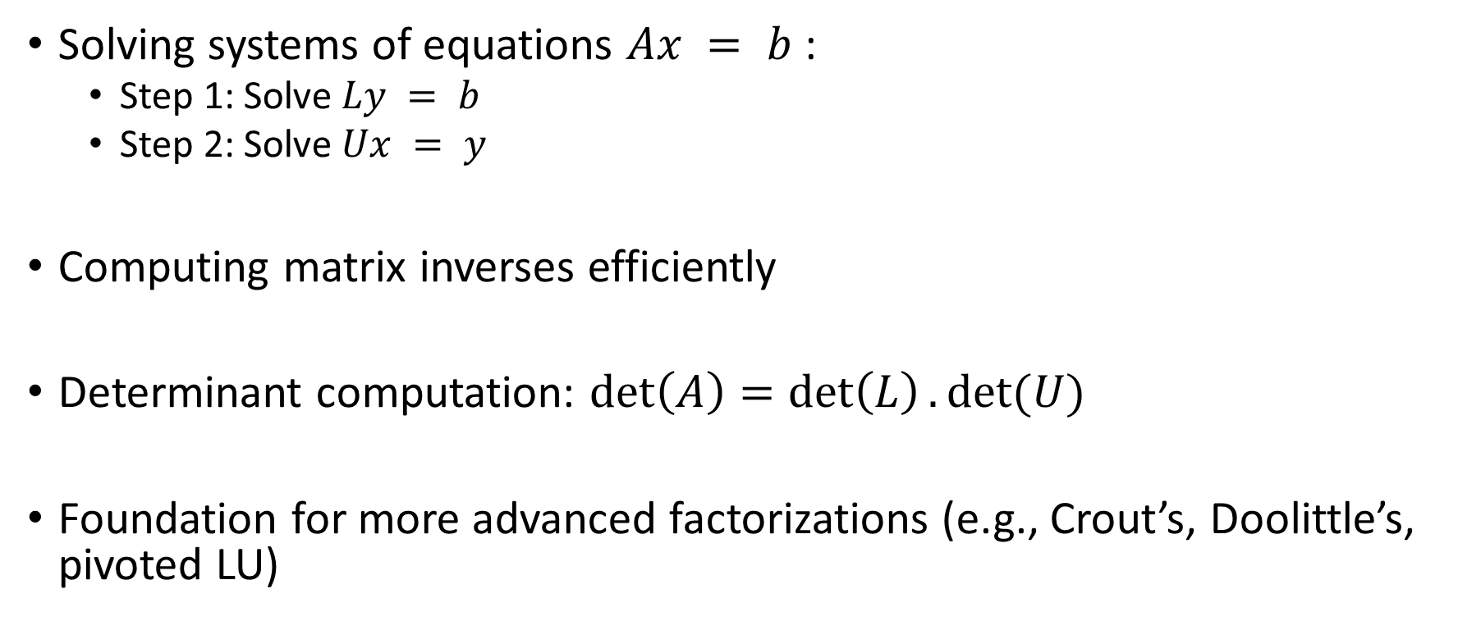
Applications in Numerical Linear Algebra
Solving systems of equations $Ax = b$:
Step 1: Solve $Ly = b$
Step 2: Solve $Ux = y$
Computing matrix inverses efficiently
Determinant computation: $det\left(A\right)=\det\left(L\right).det⁡(U)$
Foundation for more advanced factorizations (e.g., Crout’s, Doolittle’s, pivoted LU)

Slide 4
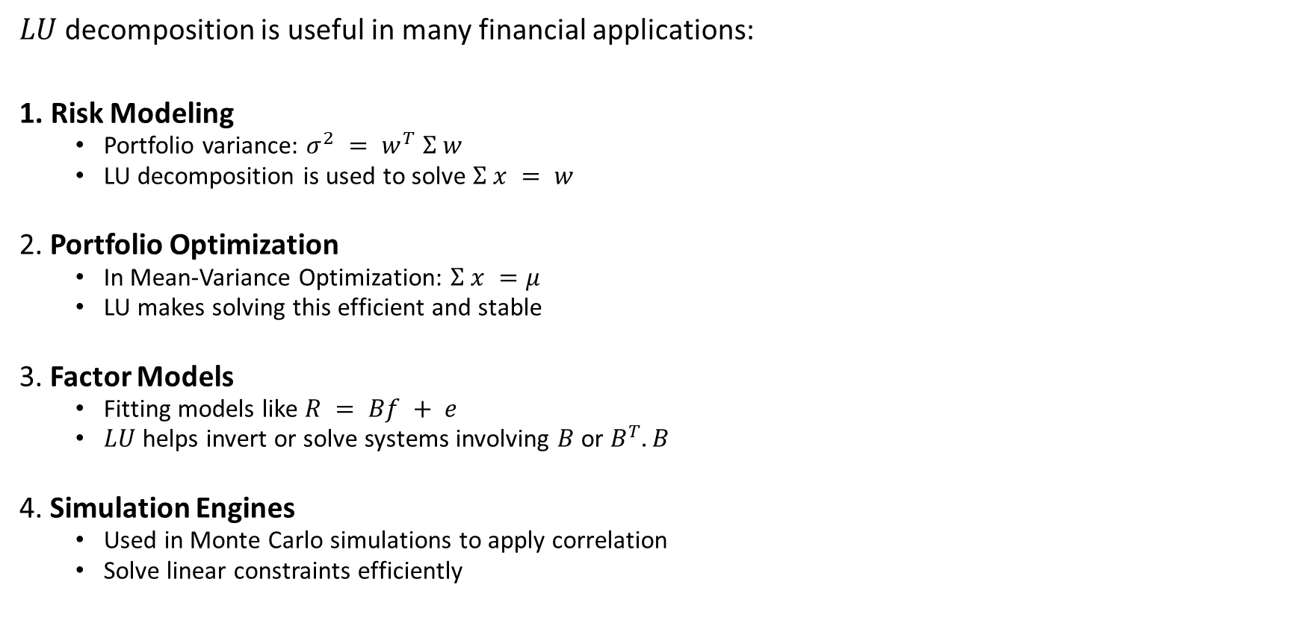
Applications in Quantitative Finance
$LU$ decomposition is useful in many financial applications:
1. Risk Modeling
Portfolio variance: $σ^{2} = w^{T} Σ w$
LU decomposition is used to solve $Σ x = w$
2. Portfolio Optimization
In Mean-Variance Optimization: $Σ x =μ$
LU makes solving this efficient and stable
3. Factor Models
Fitting models like $R = Bf + e$
$LU$ helps invert or solve systems involving $B$ or $B^{T}.B$
4. Simulation Engines
Used in Monte Carlo simulations to apply correlation
Solve linear constraints efficiently

